Slide 1
A common neural basis for contrast and motion coherence discrimination
Dan Birman
Frisem 2017-06-26

Slide 2
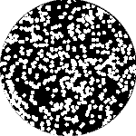

Slide 3
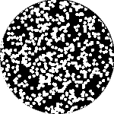

Slide 5
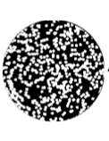
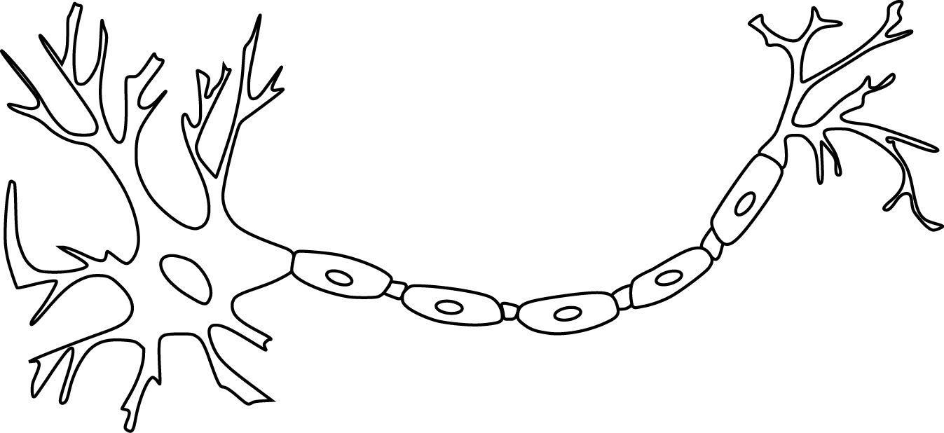

Slide 11
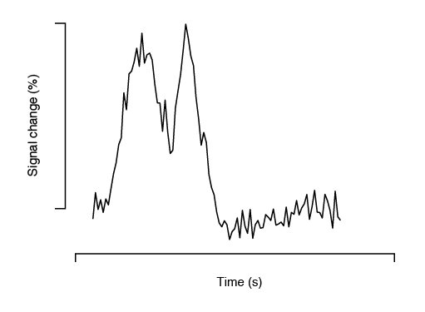

Slide 12
Encoding model of stimulus features

Slide 13
Encoding model of stimulus features
Encode contrast and motion coherence

Slide 14
Encoding model of stimulus features
Encode contrast and motion coherence
Compare to behavior (discrimination)

Slide 21
11 observers, asynchronous fixation task
800+ trials (20 per experimental condition)
1 hr retinotopy
4 x 2 hr scanning sessions

Slide 22
Area V1
Area MT

Slide 23
Within-subject analysis:
Timecourses were averaged across ROIs
Deconvolution used to obtain per-condition timecourses

Slide 32
Encoding model of stimulus features
Encode contrast and motion coherence
Compare to behavior (discrimination)

Slide 33
Encoding model of stimulus features
Encode contrast and motion coherence
Compare to behavior (discrimination)

Slide 37
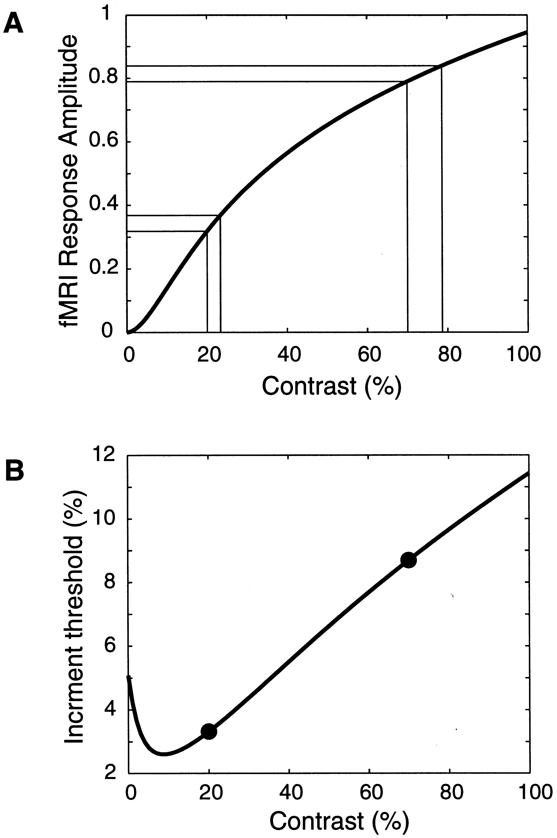
Boynton et al. 1999

Slide 40
Sensitivity = Response / Noise

Slide 45
Encoding model of stimulus features
Encode contrast and motion coherence
Compare to behavior (discrimination)

Slide 46
Encode contrast and motion coherence
Compare to behavior (discrimination)

Slide 47
Encode contrast and motion coherence
Compare to behavior (discrimination)

Slide 48
Attention?
Encode contrast and motion coherence
Compare to behavior (discrimination)

Slide 50

Thanks!
Justin Gardner

